Slide 1
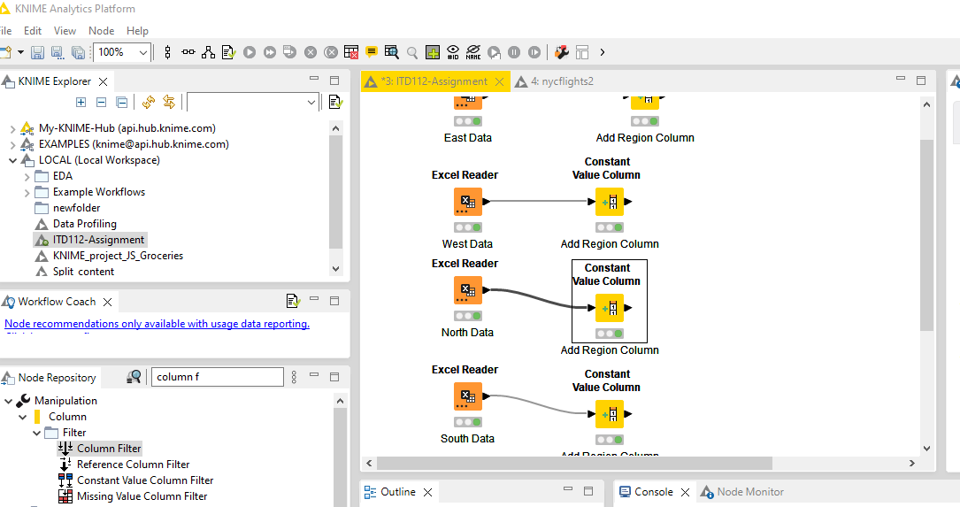
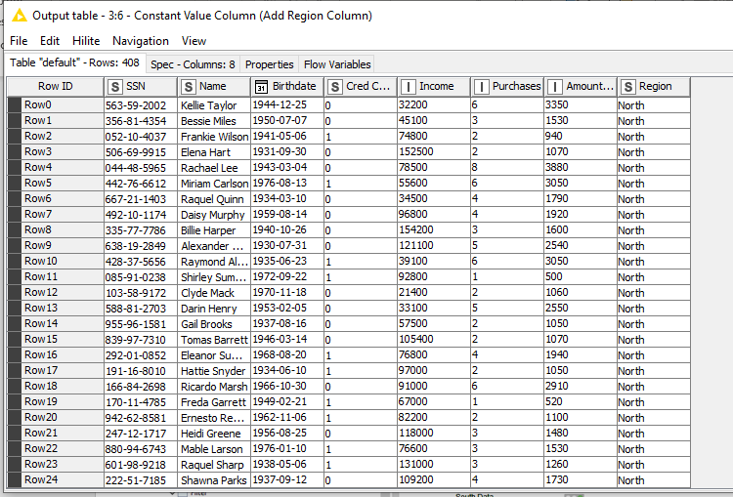
How to separate the Name into two column by the First Name and Last Name in KNIME?

